Slide 1
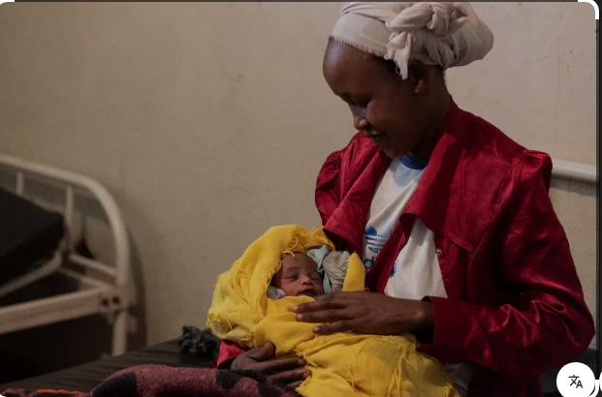
By: Dr. Rewina Legesse ( September, 2025)

Slide 2
Introduction
Postnatal care refers to care given to the mother and her newborn
immediately after birth and throughout the first six weeks (42 days)
of life. (WHO)
Positive Postnatal experience :
“One in which women, newborns, partners, parents, caregivers and families receive information,
reassurance, and support in a consistent manner from motivated health workers; where a
resourced and flexible health system recognizes the needs of women and babies, and respects their
cultural context.”

Slide 3
WHO recommends at least 4 postnatal visits:
Within 24 hours of delivery
48-72 hours after birth
7-14 days postpartum
Around 6 weeks postpartum
Why It Matters:
Addresses risk during the critical early postpartum period
Enables early identification of complications
Supports transitions to immunizations, family planning, breastfeeding

Slide 4
Core Components of Quality Postnatal Care
The guidelines gather 63 recommendations (31 new; 32 from existing
WHO sources), grouped across three domains:
Maternal care
Newborn care
Health Systems & Health Promotion

Slide 5
A) Maternal Care
1. Monitoring of Vital Signs & Physical Recovery
Check vital signs: Blood pressure, pulse, temperature, and respiratory rate
Uterine involution: Ensure the uterus is contracting and returning to its normal size
Lochia assessment: Monitor vaginal bleeding (normal progression: red → pink → white)
Perineal healing: Especially after episiotomy or tears
C-section wound care (if She delivered via c/s)
Bladder and bowel function: Monitor urination and bowel movement return

Slide 6
2. Breast Care & Support for Breastfeeding
Assess for engorgement, nipple pain, cracked nipples
Observe positioning and latch
Support exclusive breastfeeding and early initiation (within 1 hour of birth)
Provide counseling for common breastfeeding issues (mastitis, low milk supply)

Slide 7


Slide 8
3. Pain Management
Use of safe medications for perineal pain, afterpains, or cesarean pain
Cold packs, sitz baths, and topical treatments (if needed)
4. Nutrition and Hydration
Encourage nutritious, balanced meals to support healing and lactation
Assess iron, calcium, and vitamin needs (especially if anemic or breastfeeding)
Ensure adequate fluid intake

Slide 9
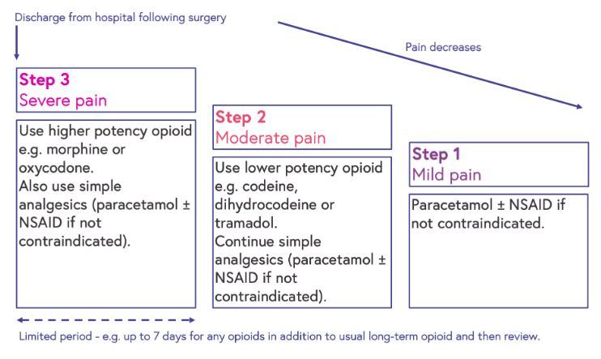

Slide 10
5 Family Planning and Birth Spacing
Discuss return of fertility
Educate about safe contraceptive options postpartum:
Lactational amenorrhea method (LAM)
Progestin-only pills/injections/implants
Intrauterine devices (IUDs)
Encourage birth spacing (minimum 2 years between pregnancies)

Slide 11
6. Mental Health Assessment
Screen for postpartum depression, anxiety, or emotional distress
Ask about sleep, feelings of sadness, hopelessness, or difficulty bonding
Refer to psychological or psychiatric services if needed
Provide emotional support and reassurance.
7. Education and Counseling
Newborn care (bathing, feeding, immunization)
Hygiene and self-care practices
Signs of complications (infection, excessive bleeding, fever)
When to seek medical attention
Reassurance and expectation setting (baby blues vs. depression)

Slide 12
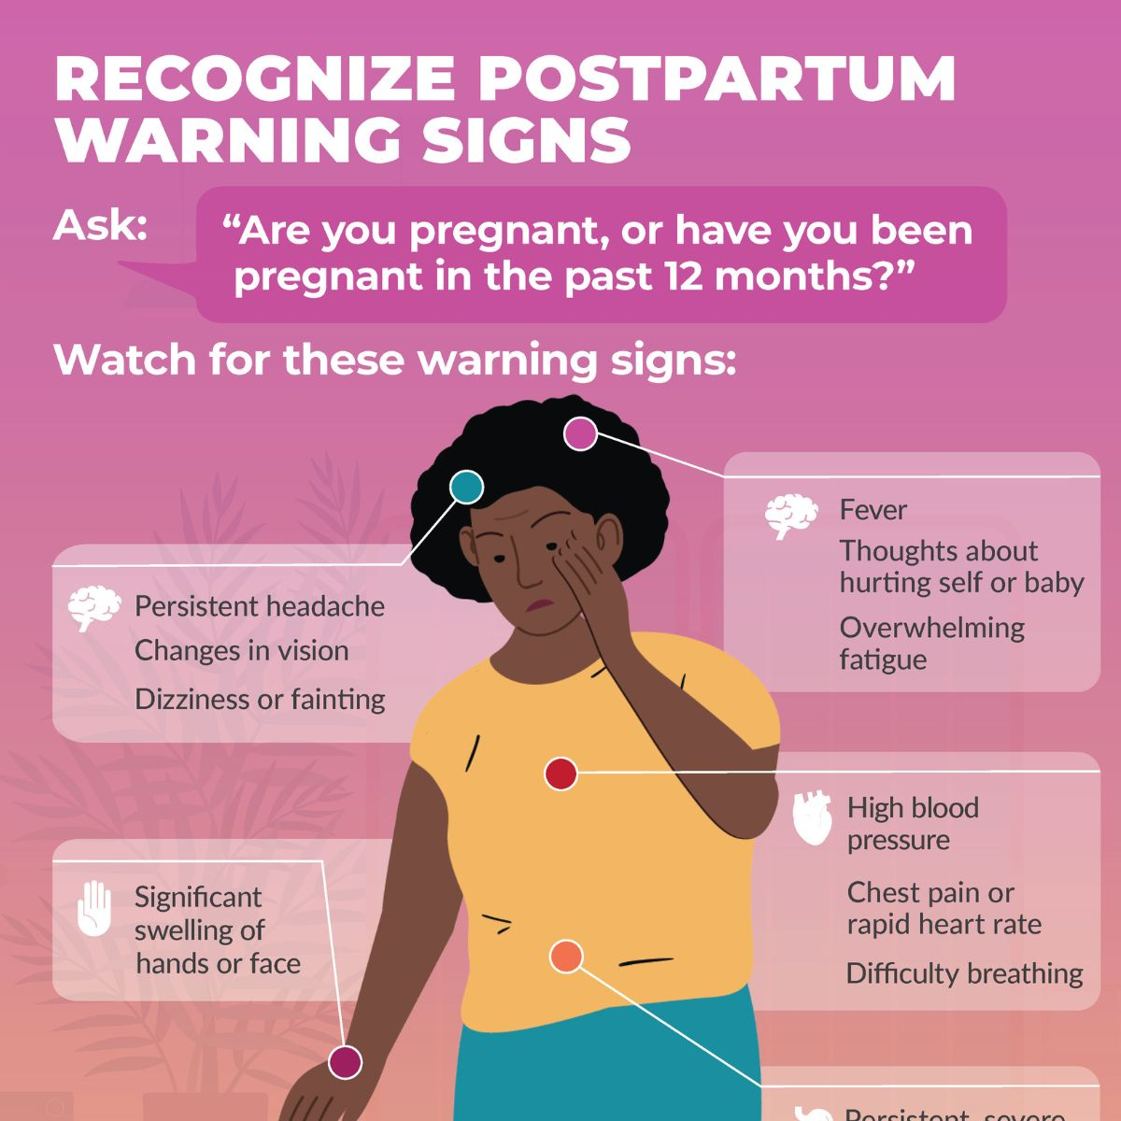
Notes:
⚠️ Warning Signs to Watch For in the Mother
Heavy bleeding (soaking >1 pad/hour)
Foul-smelling lochia
Fever, chills
Severe abdominal pain
Pain or swelling in legs
Difficulty urinating or defecating
Sadness or disinterest in baby lasting >2 weeks

Slide 13
B) Newborn Care
1. Assessment of Vital Signs and General Condition
Check:
Breathing (look for difficulty, grunting, fast or slow breathing)
Heart rate
Temperature
Color (pink, not pale or bluish)
Ensure newborn is active and feeding well.
2. Thermal Protection
Keep baby warm through:
Immediate drying after birth
Skin-to-skin contact with mother (Kangaroo Mother Care)
Appropriate clothing and room temperature
Avoid cold stress and overheating

Slide 14
3) Initiation and Support of Breastfeeding
Start within 1 hour of birth
Encourage exclusive breastfeeding for the first 6 months
Support good positioning and latch
Monitor feeding frequency and effectiveness (8–12 times/day).
4) Cord Care
Keep the umbilical stump clean and dry
Use dry cord care unless chlorhexidine is indicated (in high infection-risk settings)
Avoid applying harmful substances (e.g., ashes, oils, powders).
5) Monitoring of Elimination
Monitor:
Urine output (first pee usually within 24 hours)
Stool: First meconium within 24–48 hours
Regular urination and stool indicate proper feeding and hydration

Slide 15
6) Immunizations at Birth
Administer according to national schedule:
BCG (for tuberculosis)
Hepatitis B vaccine
Oral Polio Vaccine (OPV 0)
7) Screening and Preventive Care
Eye care (e.g., prophylaxis against gonorrheal infection)
Vitamin K injection to prevent bleeding disorders
Newborn screening tests (e.g., metabolic, hearing, congenital hypothyroidism) where available.

Slide 16
Vaccine Name | Disease Prevented | Dose | Route of Administration | Site | Timing | Notes
BCG | Tuberculosis (especially severe forms like TB meningitis) | 1 dose | Intradermal | Left upper arm | At birth (or as soon as possible within 2 weeks) | Scar formation is common. Not given if baby has symptomatic HIV or is severely ill.
Hepatitis B (HepB) | Hepatitis B virus | 1st dose (birth dose) | Intramuscular | Right thigh (anterolateral) | Within 24 hours of birth | Critical to prevent mother-to-child transmission of Hep B.
Oral Polio Vaccine (OPV 0) | Poliomyelitis | 0 dose (not counted in series) | Oral (drops) | Mouth | At birth (or within 2 weeks) | Boosts mucosal immunity; part of polio eradication efforts.
(Optional in some countries) Vitamin K injection | Prevents bleeding disorders | 1 dose | Intramuscular | Left thigh | Within 1 hour of birth | Not a vaccine, but essential to prevent hemorrhagic disease of the newborn.

Slide 17
Vaccine | Recommended Time | Latest Acceptable Time | Notes
BCG | At birth (within 24 hours) | Ideally within 2 weeks, acceptable up to 12 months if not previously given | Delayed in sick/preterm babies. Not given if signs of immunodeficiency (e.g., symptomatic HIV).
Hepatitis B (birth dose) | Within 24 hours of birth | Within 7 days (preferably ≤24 hrs) | Giving it beyond 24 hrs reduces protection against mother-to-child transmission but still beneficial up to 7 days.
OPV 0 (Oral Polio Vaccine) | At birth | Up to 14 days of age | After 14 days, skip OPV 0 and follow routine OPV schedule (at 6, 10, 14 weeks).
Vitamin K (injection) | Within 1 hour after birth | Up to 7 days, IM preferred | If missed, oral vitamin K can be given (varies by setting), though less effective.

Slide 18
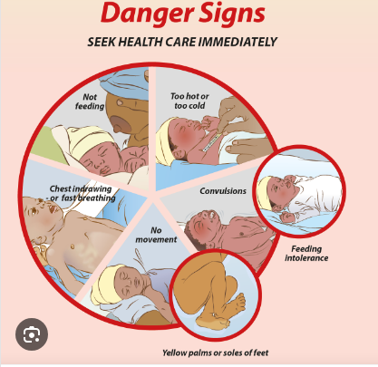
Notes:
Parents should be educated to seek medical care if the baby has:
Difficulty breathing
Poor or no feeding
Fever (>37.5°C) or hypothermia (<35.5°C)
Lethargy or unresponsiveness
Convulsions
Jaundice (yellowing of eyes or skin, especially <24 hours after birth or worsening)
Pus or bleeding from umbilical stump
Vomiting everything

Slide 19
c) Health systems & Health promotion
Ensure at least 24-hour stay after an uncomplicated vaginal delivery.
Conduct structured discharge assessments before sending mother and baby home.
Provide clear, culturally appropriate instructions on:
Danger signs
Breastfeeding
Newborn care
When and where to return for follow-up
Ensure continuity of care after discharge (via referrals or home visits).

Slide 20


